Slide 1

Overseas Only
Clinical Cases
Intensity Focused Ultrasound System
TDT™(Thermal Diffusion Treatment) Technology

Slide 2
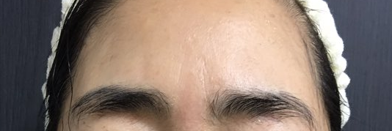
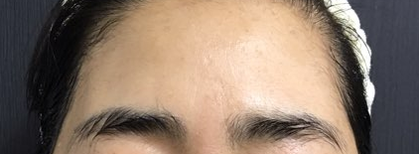
Clinical Cases
Before
Immediately, 1 sessions
Pen Applicator : 7 MHz - 1.5 mm & 7MHz - 3.0 mm / Energy : 0.4 J / Shot Count : 500 shot

Slide 3


Clinical Cases
Before
Immediately, 1 sessions
Pen Applicator : 7 MHz - 1.5 mm & 7MHz - 3.0 mm
Energy : 0.5 J ~ 0.7 J
Shot Count : 300 shot

Slide 4
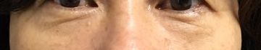
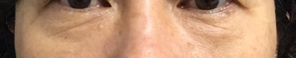
Clinical Cases
Before
1 months, 1 sessions
Pen Applicator : 7 MHz - 3.0 mm
Energy : 0.5 J
Shot Count : 300 shot

Slide 5
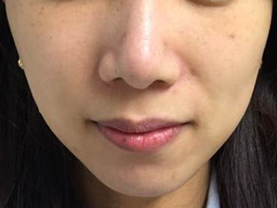
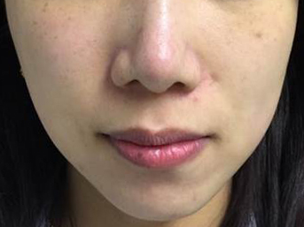
Clinical Cases
Before
1 months, 1 sessions
Pen Applicator : 4 MHz - 4.5 mm
Energy : 0.6 J
Shot Count : 1,500 shot

Slide 6
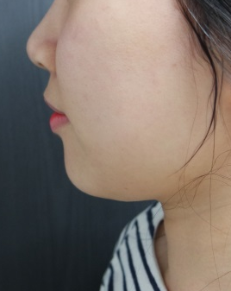
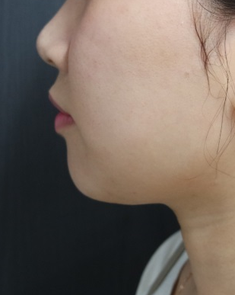
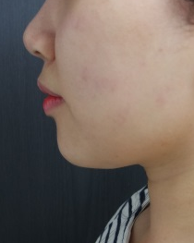
Clinical Cases
Before
Immediately
1 months, 1 sessions
Pen Applicator : 4 MHz - 4.5 mm
Energy : 0.7 J
Shot Count : 3,000 shot

Slide 7
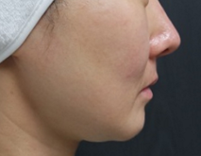
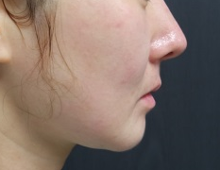
Clinical Cases
Before
1 months, 1 sessions
Pen Applicator : 4 MHz - 4.5 mm
Energy : 0.7 J
Shot Count : 2,500 shot

Slide 8
Combined procedure
Fat injection
Face lift
Laser / RF
HA Filler
Collagen stimulator such as PLLA
Thread lift
Skilled physician can perform faster and more effective treatment by using Liftera V.
Physician can save more procedure time rather than other HIFU devices.
Therefore, it is easier to apply the combination program with other procedures at the same time.

Slide 9
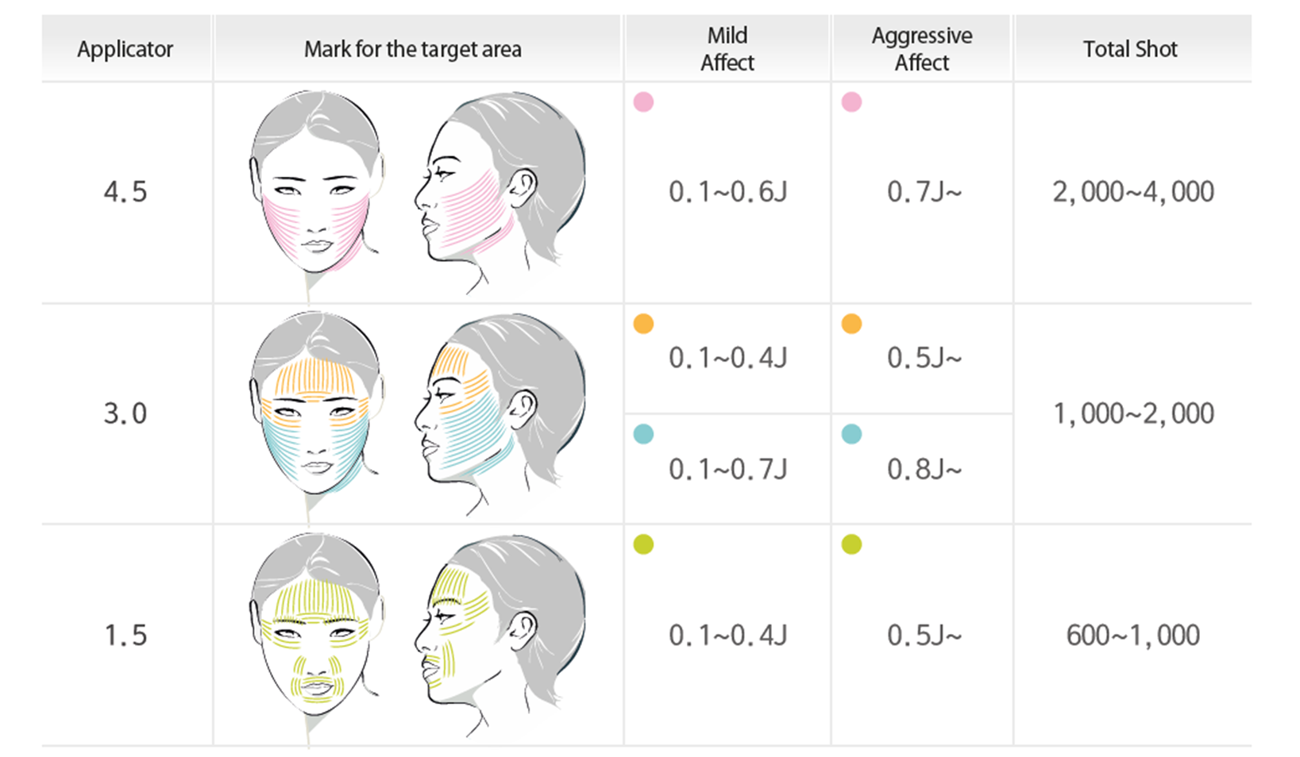
Parameter

Slide 10
Thank you.

